Slide 1
ALAGELLE SYNDROME
Presented by : Jayanthy Balakrishnan
PHDU
24/01/2022

Slide 2
ALAGELLE SYNDROME
Alagelle syndrome (ALGS) is a rare genetic disorder that affects multiple organs in the bodies and cause variety of abnormalities . It can tipically affects the liver but it also cause problem in the heart, kidneys ,eyes and bones.

Slide 3
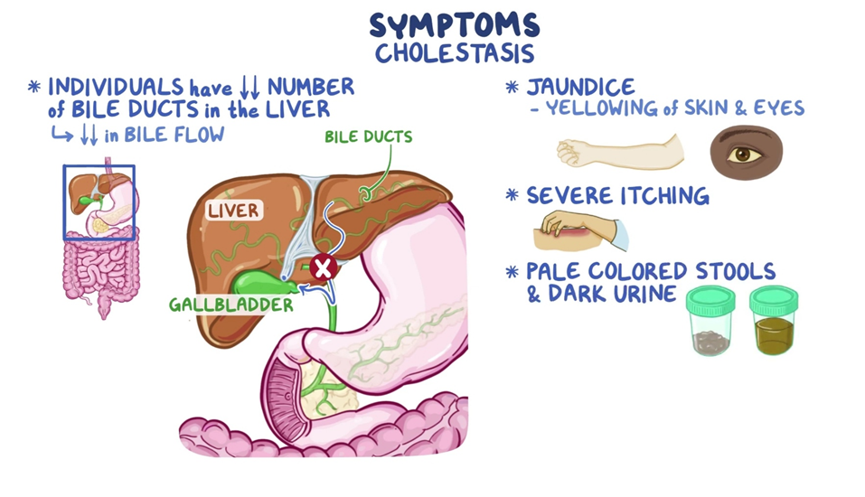
Cholestasis
Affected individuals have reduced number of bile ducts in the liver ,as a result decrease in bile flow known as cholestasis .The symptoms and signs include__ jaundice(yellowing skin and eyes )severe itching , pale coloured stool and dark urine. Some patients may have Enlarged liver or Spleen.

Slide 4
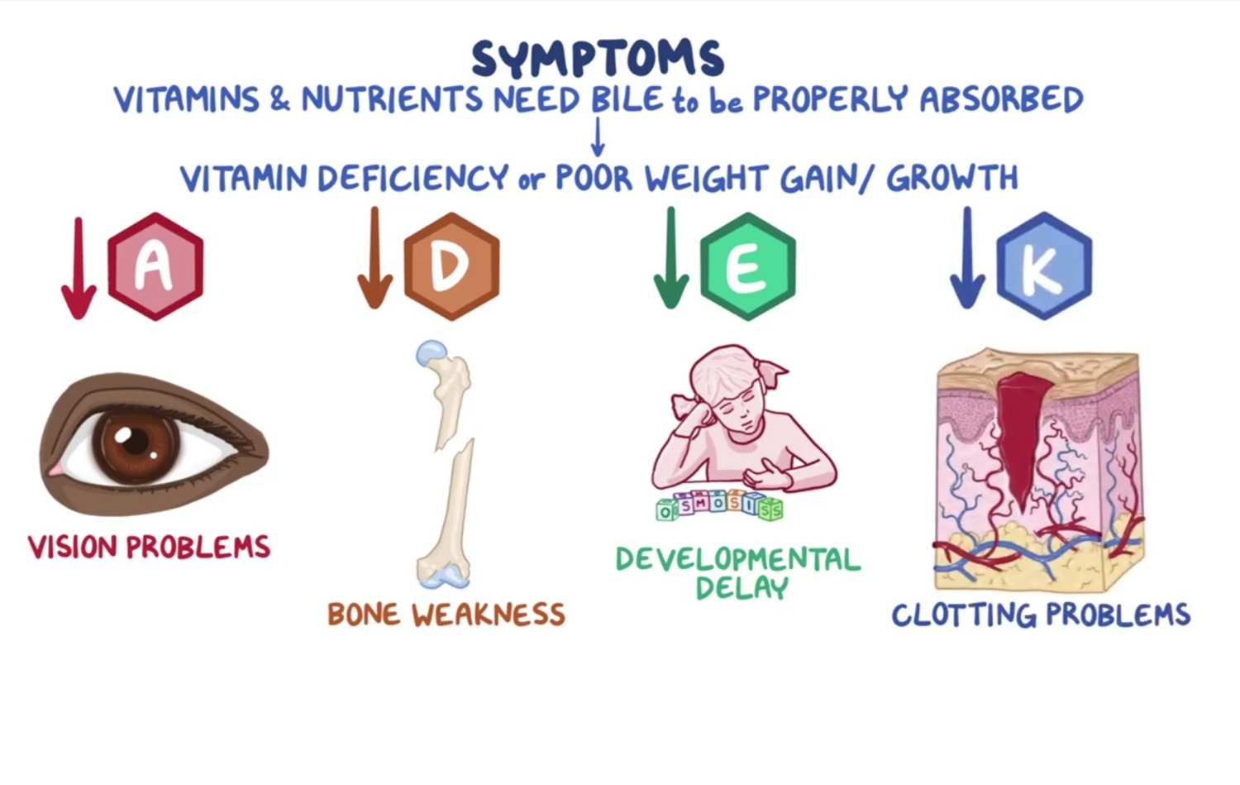

Slide 5
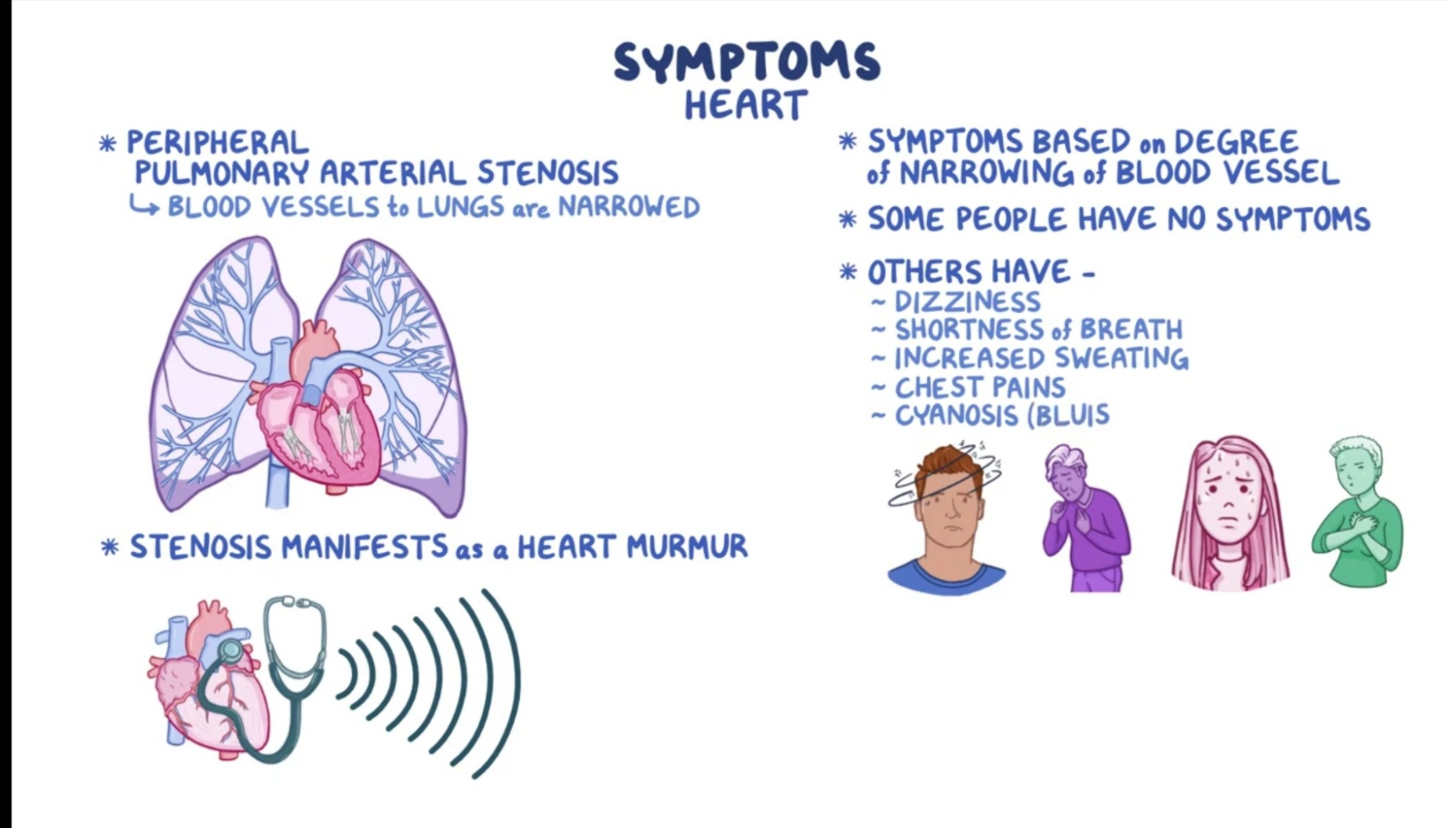

Slide 6
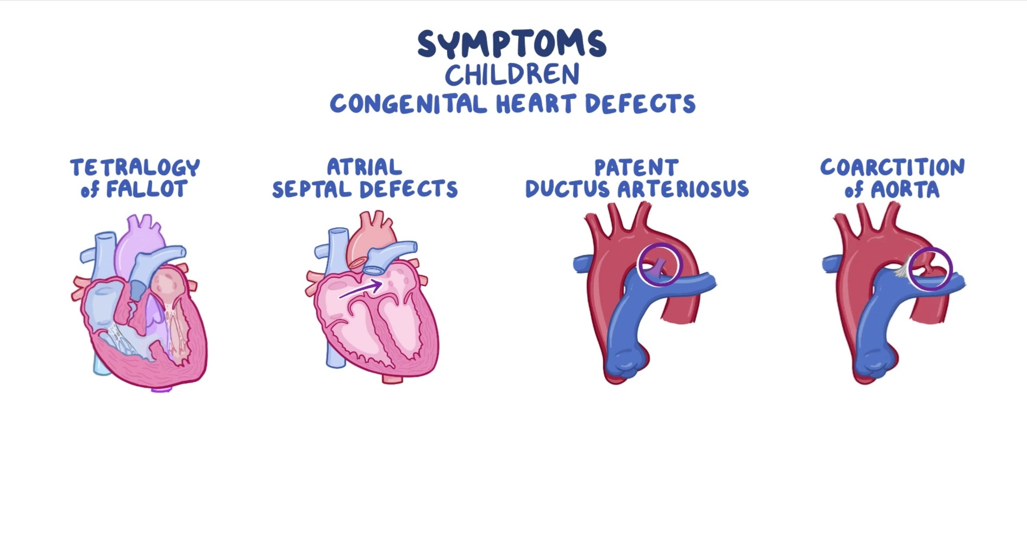

Slide 7
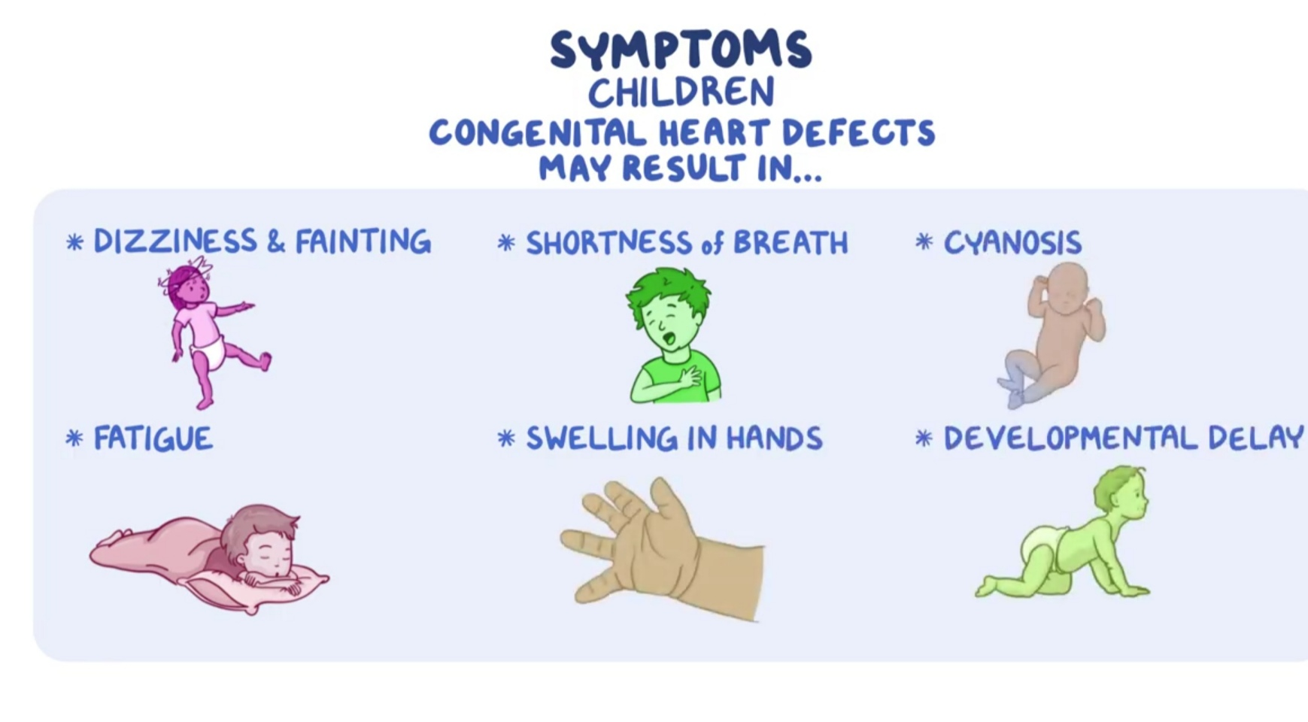

Slide 8
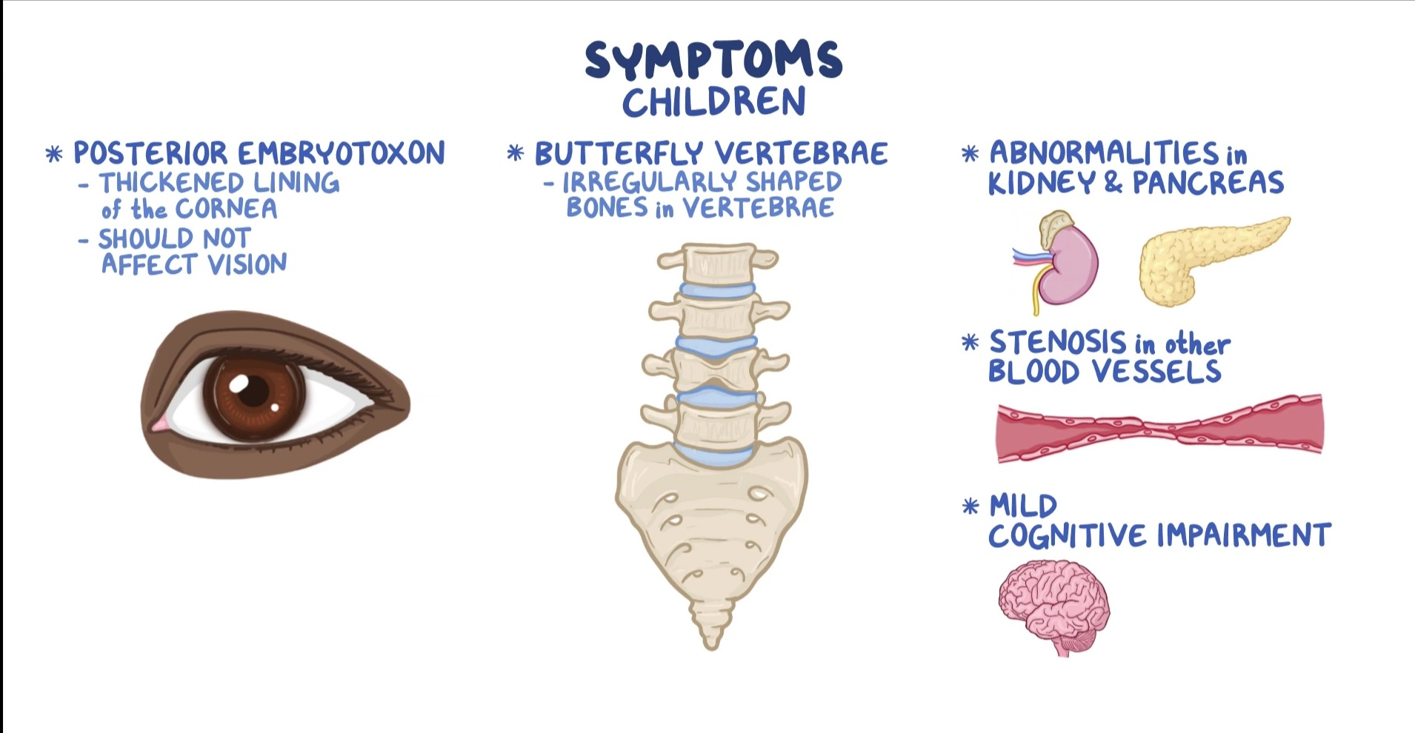


Slide 9
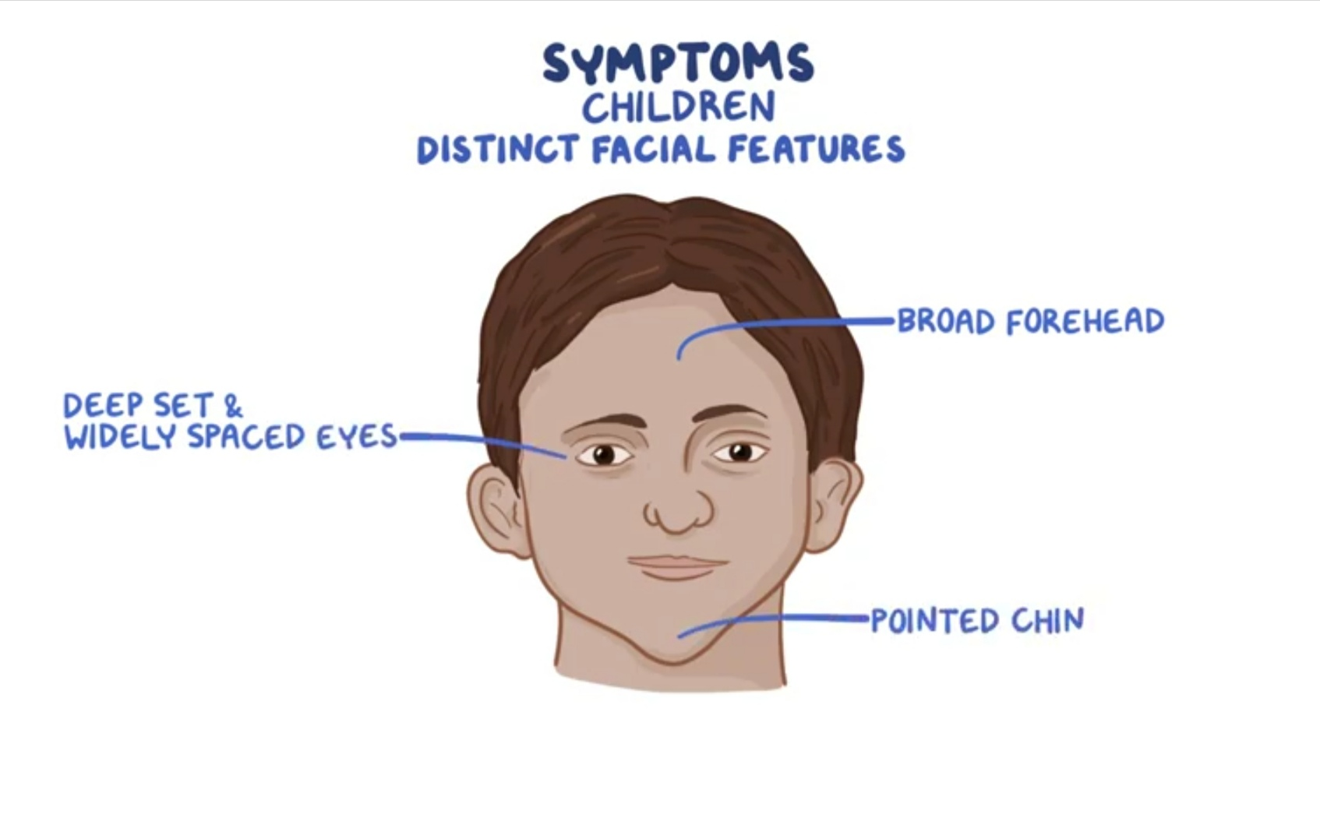

Slide 10
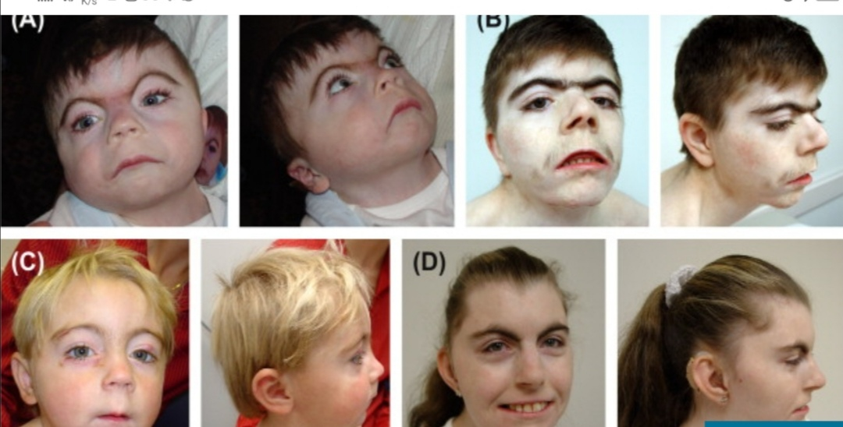
FACIAL FEATURS OF ALGS

Slide 11
Complications
ALGS can lead to complications that affect the liver and other organs of the body . It varies from person to person.
Liver complications:
1.Hepatomegaly
2.Portal HTN(increased the pressure in protal vein)
3.Liver failure: needs liver TX
4.Liver cancer

Slide 12
OTHER COMPLICATIONS OF ALGS
serious heart defects
narrowing and weakness in the blood vessels and in the brain leads to bleeding and stroke
problems with growth, delayed puberty , failure to thrive , bone problems such as osteoporosis or frequent broken bones.
Kidney problems : some children have impaired kidney function such as kidney artery stenosis ,lipoid nephrosis
Pancreatic insufficiency leads fat malabsorption

Slide 13
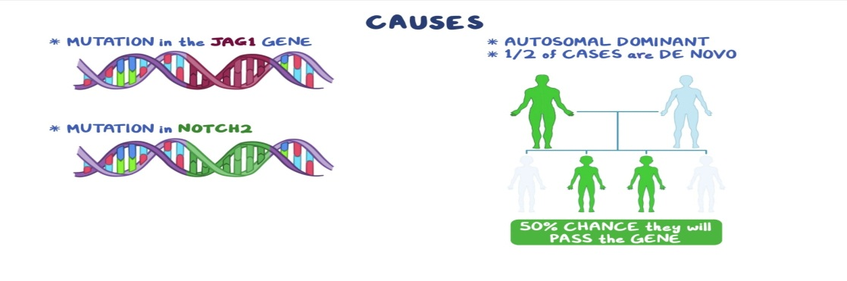
CAUSES of ALEGELLE SYNDROME
Most people with alegelle syndrome have a mutation in the JAG1 gene however some patient have a mutation in the NOTCH2 gene instead . These mutations are inherited autosomal dominant mannner,which means only single copy of the mutated gene is nessessary cause the disorder.
If the parent carries the mutated gene there is 50% chance they will pass the gene on to each of there offspiring.However half of the allegelle syndrome cases are caused by a DE NOVO mutation meaning they arise on their own and are not inherited

Slide 14
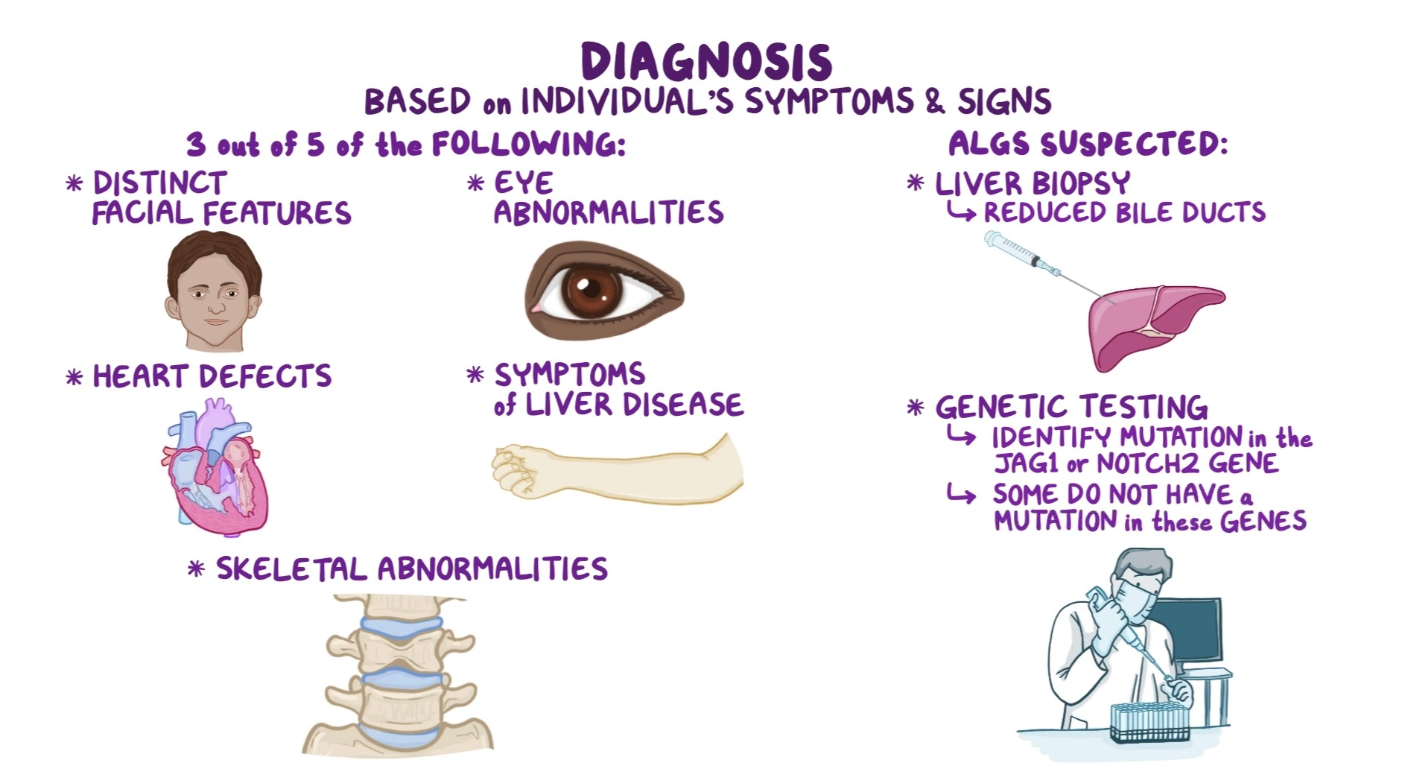

Slide 15
Treatment
Depends on a specific symptoms:
It often requires cordinated effort with in medical team
Pediatrian ,Gastroenterologists ,cardiologist and others
1. Supplemental treatment:
Vitalmins and nutrient to help with growth problems
2.Ursodeoxycholic acid(to improve bile flow)
3.Severe itching improved with proper hydration and antihistamines
If the infants and children who do not respond to treatment may require surgery ---partial biliary divertion to increase bile flow.
In case of progressive liver disease the patient may requierd liver transplant.
Confirmed diagnosis need genetic councilling sugessested to evalluate and understand the family risks.

Slide 16
ALGS AND NUTRITION
The doctor to refer the patient to the Dietician and Dietician will suggest the food that contains carbohydrate and fat , called medium chain tri glycerides (MCT),it will digest easily.
Special formula milk with MCT
Daily weight to be check.
If poor oral intake , can insert NGT and feed the patient

Slide 17
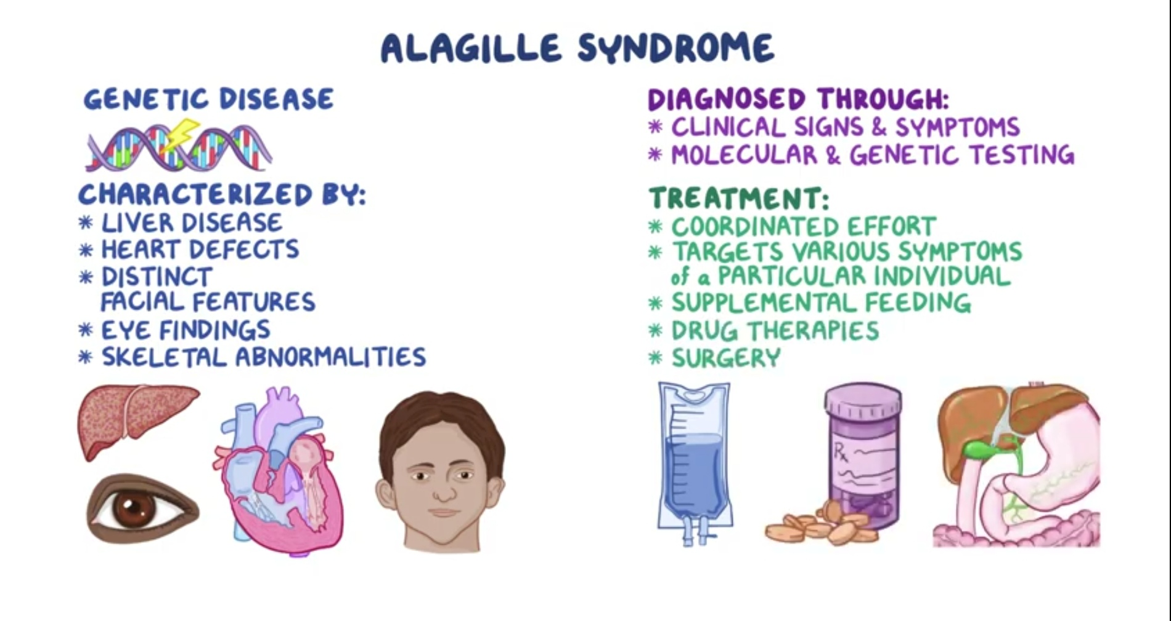

Slide 18
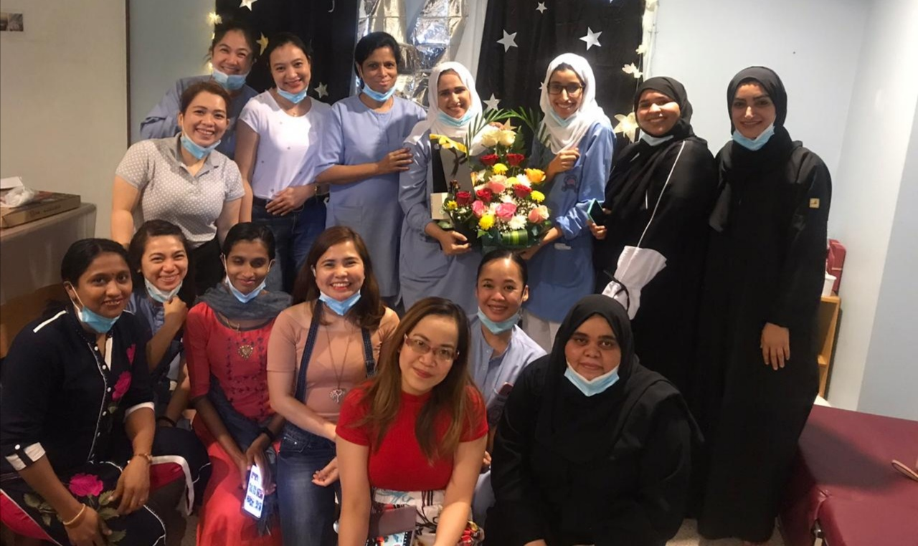
SHUKRAN

Slide 19


